Slide 1
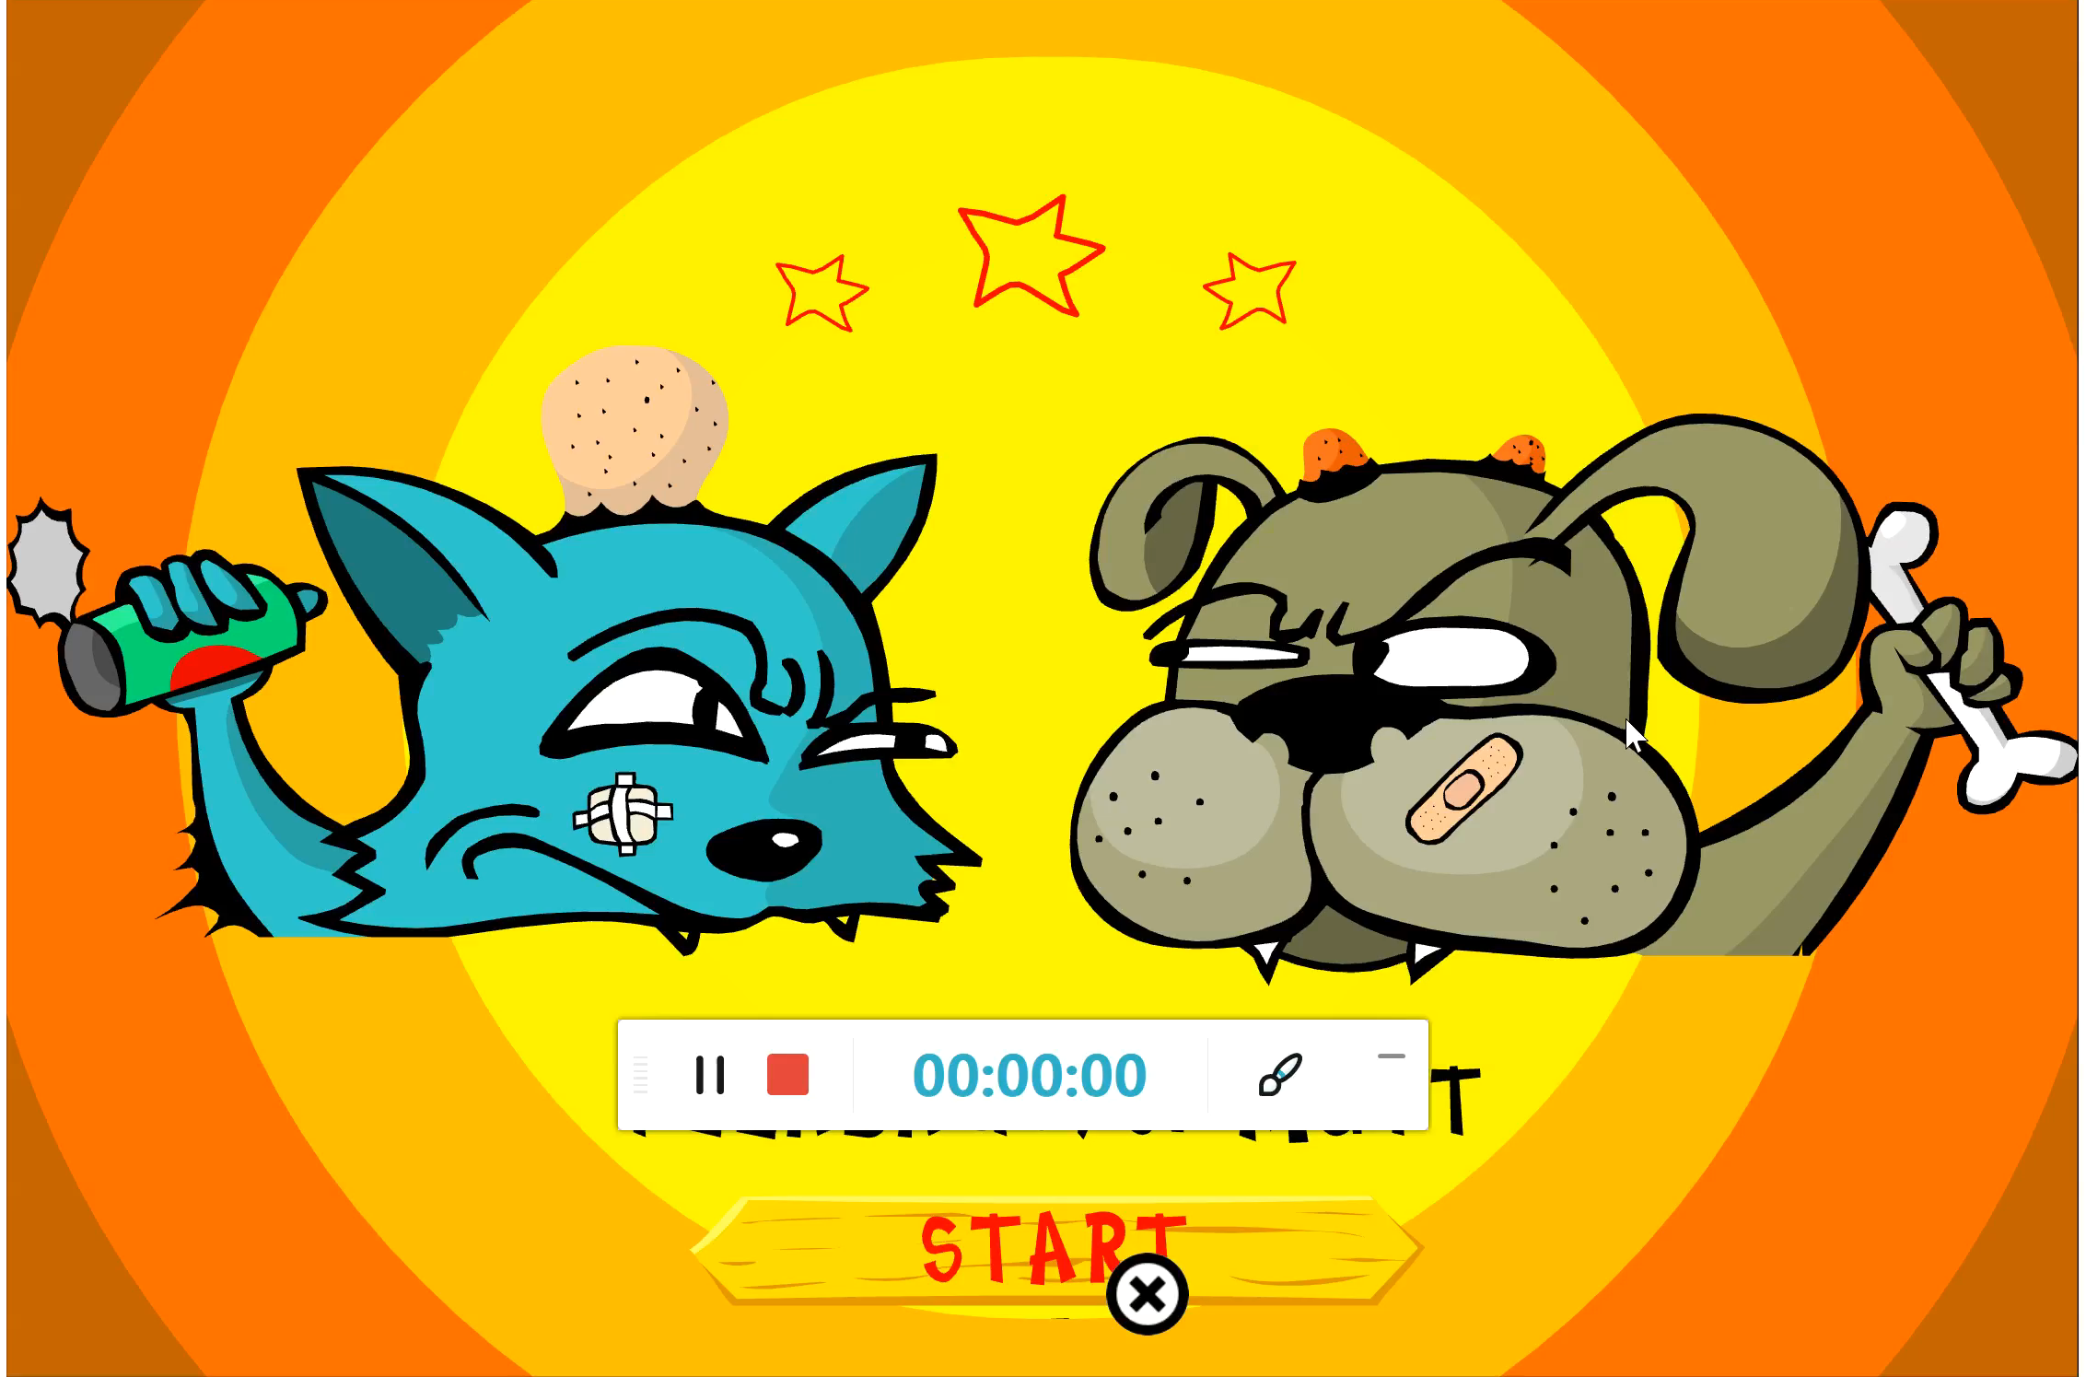
Flea Bag Vs Mutt
Game Mechanics
1. Different Levels
2. Turns
3. Randomizers
4. Risk Rewards
Score system
User
1. Choose Gameplay Level
2. Choose number of players
3. Powerups
4. Turns
Game Control
Scoring
Wind direction
Sounds and Reactions based on victory
Game Mechanics
1. Different Levels
2. Turns
3. Randomizers
4. Risk Rewards
5. Score system

Slide 2
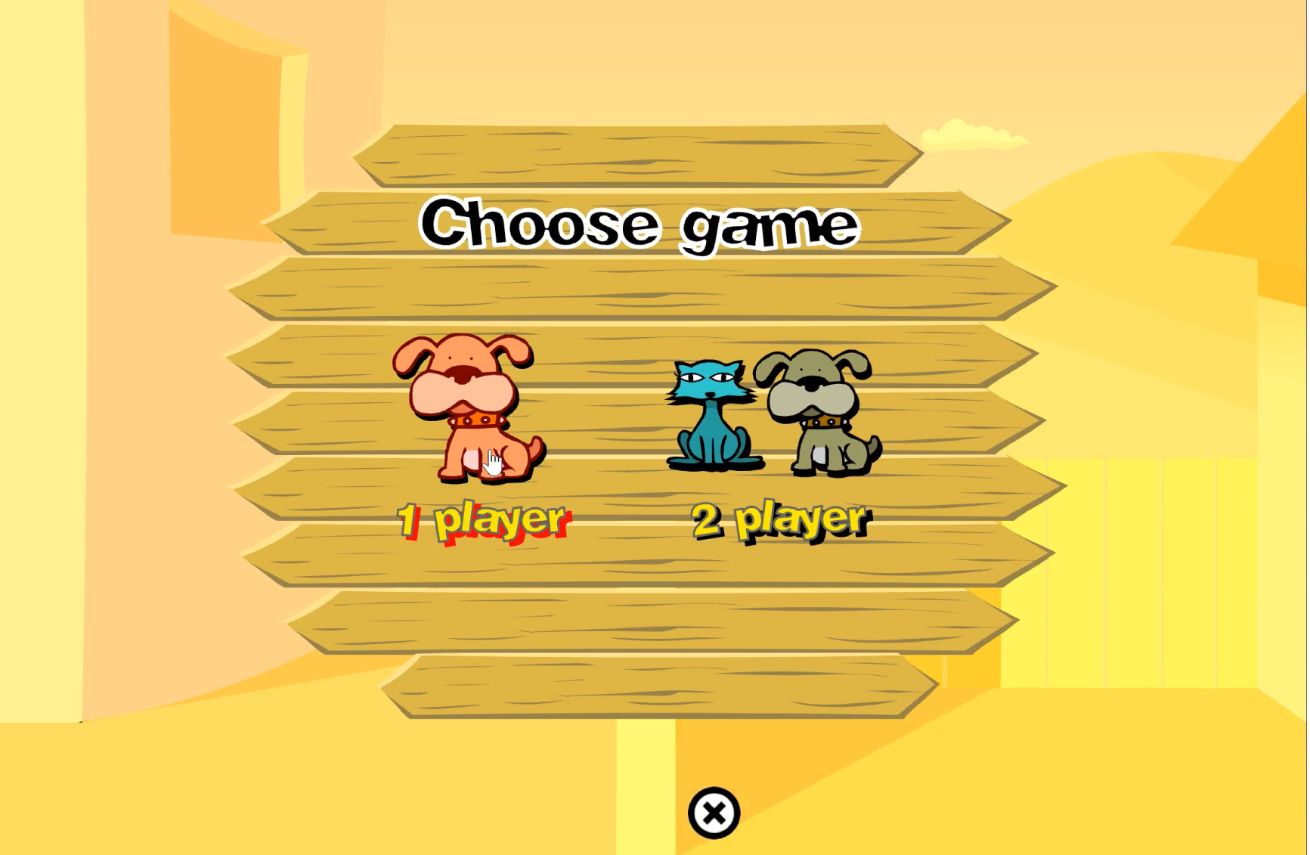
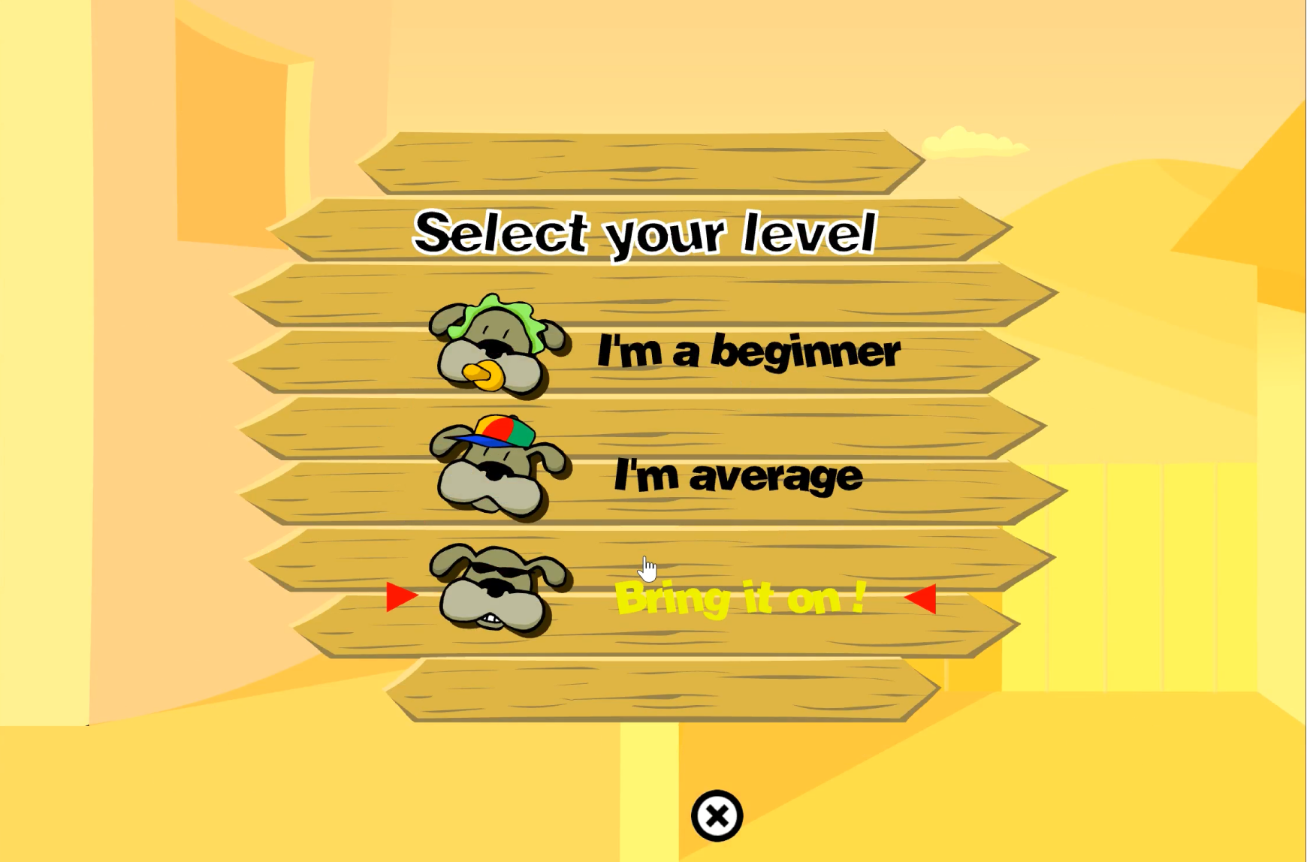
Freedom to choose players and difficulty levels

Slide 3
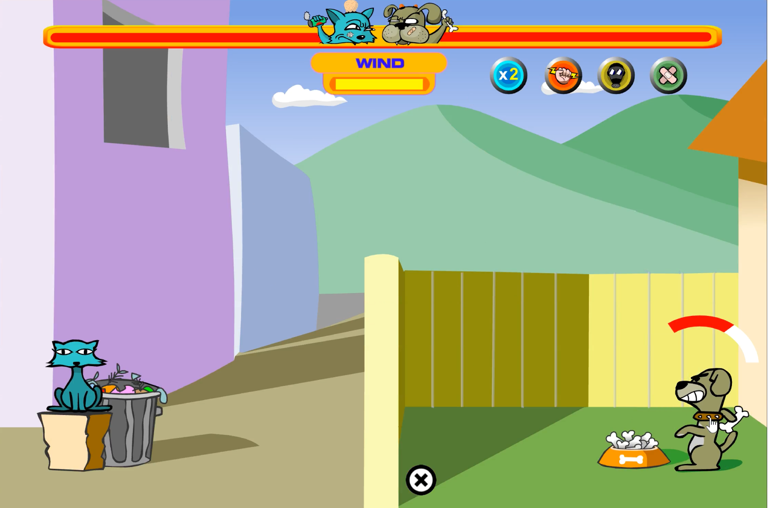
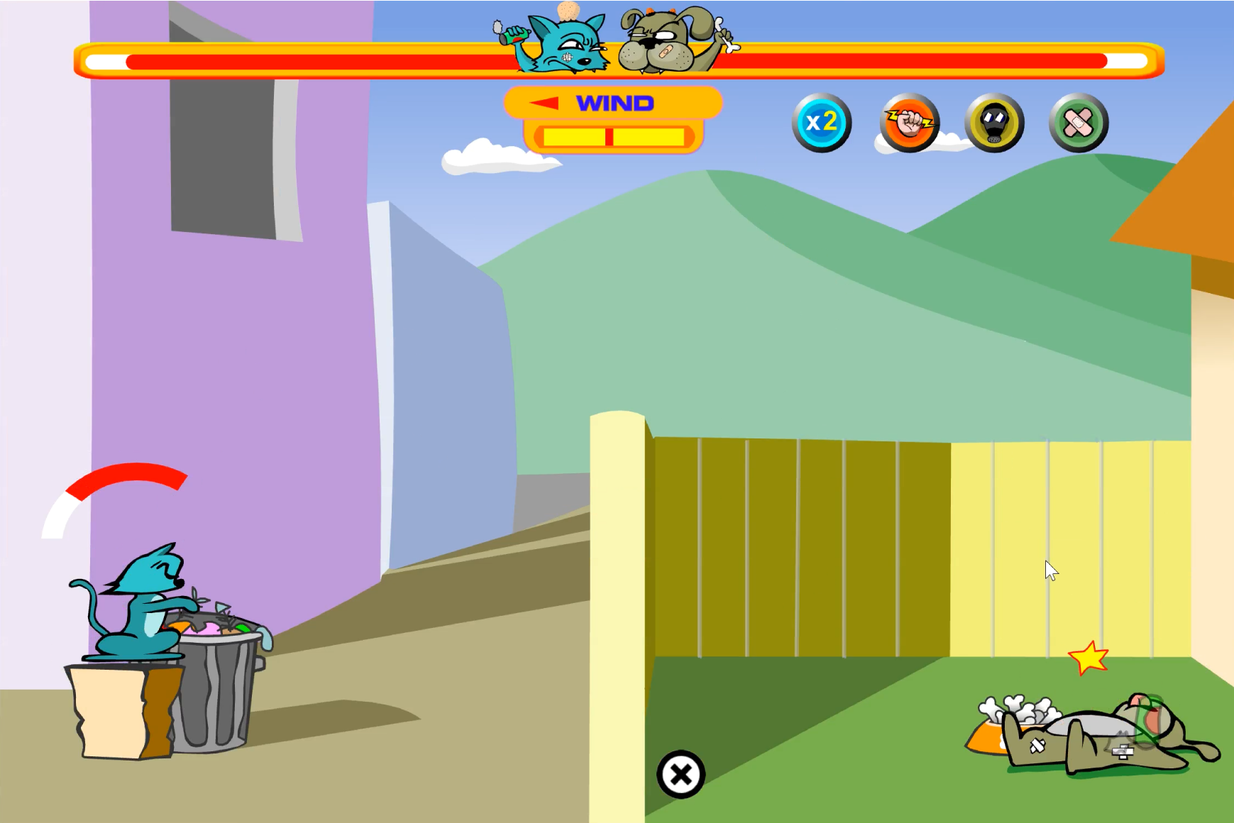
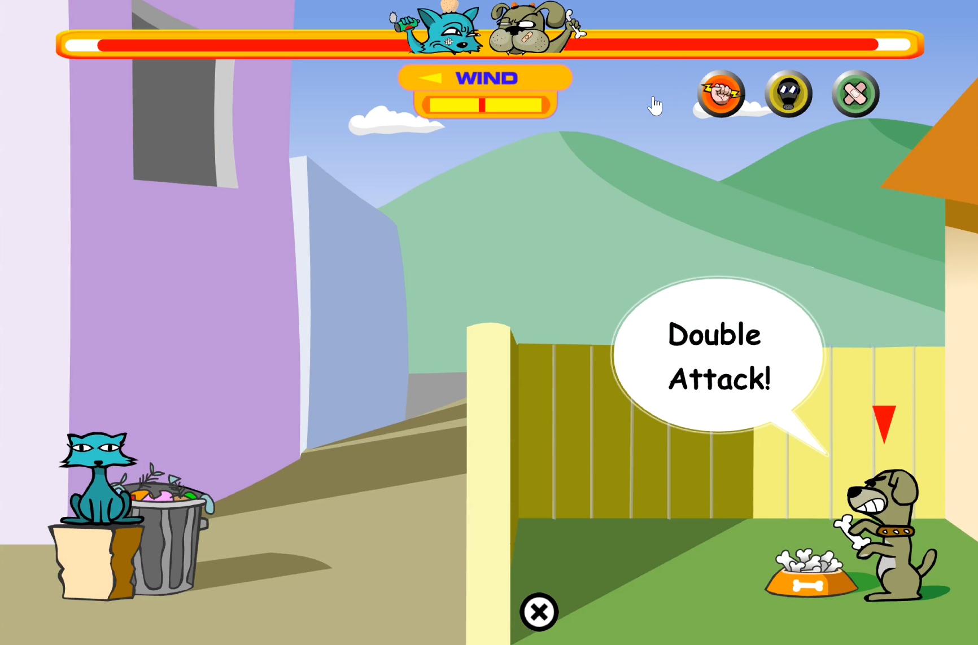
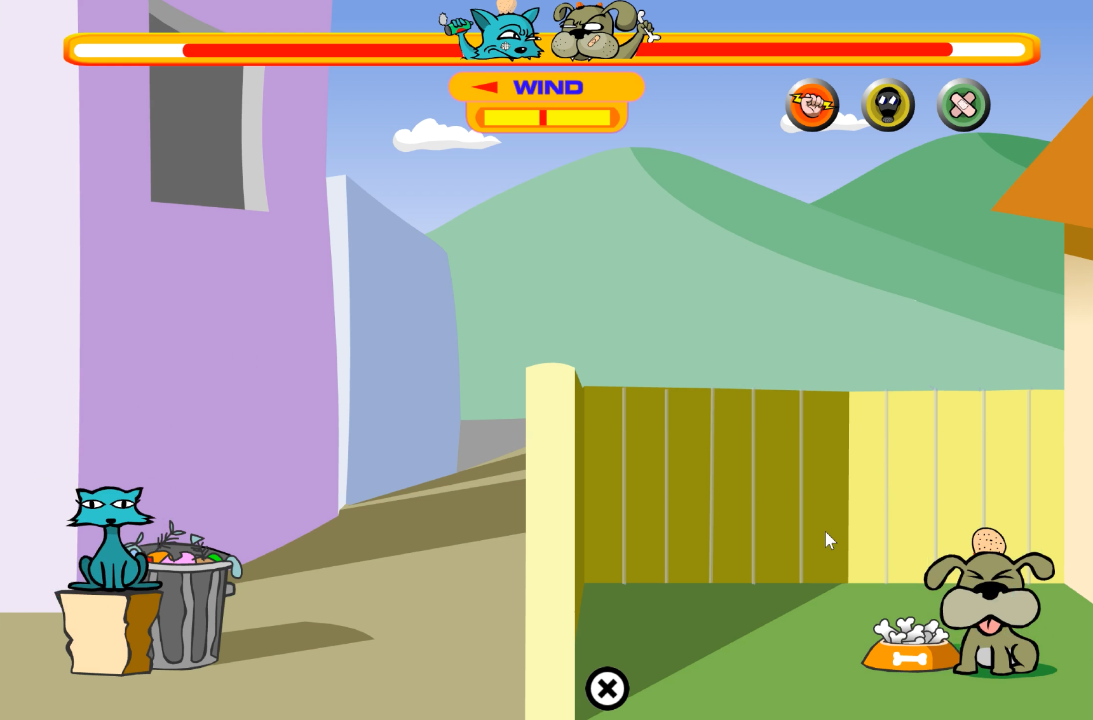
Turns
Randomizers
Scoring and Victory Conditions
Powerups and Risk rewards

